Slide 1
Family and Friends
WEEK 8

Slide 2

Fiesta de quince años- A Quinceañera
The most important day of a girl’s life in Latin America.
https://www.youtube.com/watch?v=GDfR6N4RgFM&ab_channel=TLC
Intrigued
Embrace
Bridal
Capture memories
Intrigue verb [ T ] /ɪnˈtriːɡ/ If someone or something intrigues you, they interest you very much.
Embrace verb /ɪmˈbreɪs/ If you embrace someone, you put your arms around them; to accept new ideas, beliefs; include a number of things
Bridal adjective /ˈbraɪdəl/ relating to a woman who is getting married, or relating to a wedding
Capture memories /ˈkæptʃər/ catch memories

Slide 3

SUFFIX -AL
Read the sentences from the article. Match the words in bold with the correct meaning.
d
1. A girl's fifteenth birthday is a huge social occasion for many Latin American families.
2. The tradition has become international, spreading through Central and South America.
3. It marks a time of important personal change.
4. The event has both personal and historical importance.
a. Connected with many countries
a
b. Connected with the past
c
c. Connected with a person
b
d. Connected with groups of people

Slide 4
SUFFIX -AL
Complete the sentences with these adjectives.
Cultural | emotional | traditional | typical
1. The fiesta de quince años is hundreds of years old. It's a Mexican celebration. 2. Certain things are expected at most parties. At a party, the girl's father removes her shoes. 3. The party brings out strong feelings. The shoe-changing can be a very moment. 4. It's part of the Mexican way of life, but many countries don't have a tradition like this.
traditional
typical
emotional
cultural

Slide 5
SUFFIX -AL
What adjectives can you make from these nouns? Be careful. You need to remove a letter from some nouns.
centre
music
nature
politics
profession
central
musical
/ˈneɪ.tʃɚ/
natural
/ˈnætʃ.ɚ.əl/
political
professional

Slide 6
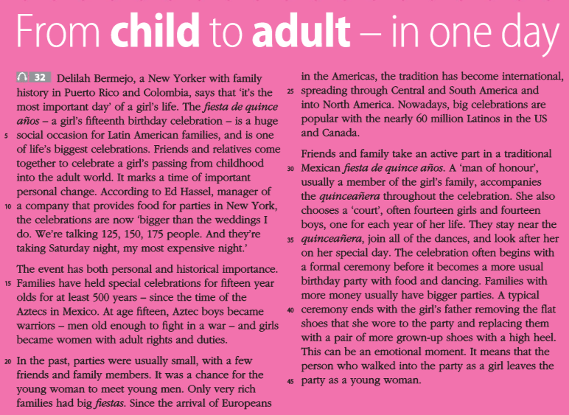
Read the article and choose the topic and main idea.
1. Topic
Latin American celebrations
The fiesta de quince años
Becoming an adult
2. Main idea
The culture of ancient Mexico has affected all of Latin America.
The fiesta de quince años shouldn't be more important than a wedding.
A girl's fifteenth birthday is one of the most important celebrations for Latin American families.

Slide 7
Read the article again. Are the sentences true, false, or is the information not given?
1. According to the article, the biggest fiestas de quince años are held in Spain.
2. In the US, the fiestas usually aren't as big as weddings.
3. The history of the fiesta goes back more than 500 years.
4. There are over 500,000 fiestas in the US a year.
5. Some fiestas in the US last for a week.
6. New shoes show that the girl has become a young woman.
NG
F (11–12)
T (15–16)
NG
NG
T (43-45)

Slide 8
Find information in the article to support each sentence.
1. The fiesta de quince años is an international celebration.
2. The girl is seen as a different person after the celebration.
3. The celebrations have become bigger over time.
4. People spend a lot of money on a fiesta de quince años.
5. The celebration is a very old tradition.
Lines 9-10; 24; 25; 26-28.
Lines 7-8; 18-19; 43-45
Lines 20-21; 26-28
Lines 11-13
Lines 15-17

Slide 9
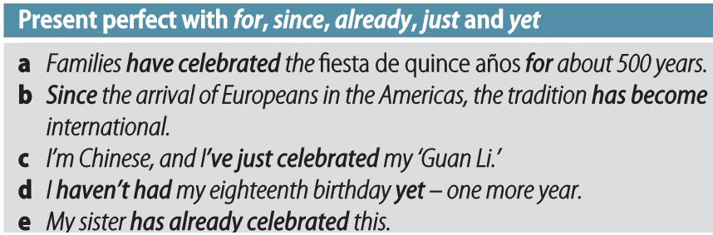
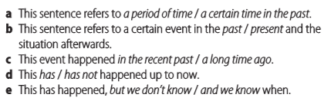
PRESENT PERFECT- FOR, SINCE, ALREADY, JUST AND YET
Look at the Grammar box. Choose the correct option to complete the explanation for each sentence in the Grammar box.

Slide 10
PRESENT PERFECT- FOR, SINCE, ALREADY, JUST AND YET
Complete the exchanges with for and since.
1. A: I haven't seen my cousins last month.
B: Really? I haven't seen mine almost three years.
2. A: We've been friends ten years.
B: Yeah, I guess you're right. We've known each other we were five years old.
3. A: Has your brother been in the running club long?
B: Not really. He's been a member January.
since
for
for
since
for
since

Slide 11
PRESENT PERFECT- FOR, SINCE, ALREADY, JUST AND YET
Complete the text with just, already or yet.
'Comedy is kind of a language, so you're connected and relating.' – Gad Elmaleh
Moroccan-born comedian Gad Elmaleh has taken a lot of English lessons in his life, but jokes that he doesn't really speak English (1) . However, that hasn't stopped him from performing comedy for American audiences. Although he arrived in the US fairly recently, he's (2) done shows in New York, Los Angeles and lots of cities in between. He's (3) completed a tour of more than ten US cities, and plans to continue performing.
Although Gad has (4) started his comedy career in America, he's (5) become a superstar in Europe – especially France. In the US, he hasn't become that popular (6) . His career, like his English, is a work in progress.
yet
already
just
just
already
yet

Slide 12
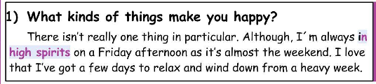
Speaking Assessment 3
Structure of your answers:
Rising the argument(s) / answer.
Providing examples / explaining the arguments.
Merging them together (optional).
https://www.youtube.com/watch?v=GQkY6jsn1GU&t=1s&ab_channel=IELTSSPEAKINGTEST

Slide 13
Speaking Assessment 3
Student A (About Friends):
1. Do you have any (or, many) close friends?
2. Do you often go out with your friends?
3. What qualities make them good friends?
Student B (About Family):
1. Do you live with your family?
2. Do your family still live in your hometown?
3. When do you spend time with your family?

